Slide 1
Web Design Workshop
October 18th, 2013
itp.nyu.edu/residents/web_design/
Danne Woo
dannewoo@nyu.edu

Slide 2
Overview
Discover
Define
Design
Develop
Market Research and Analysis
Sitemapping and Wireframes
Styling the Look and Feel
Programming (CSS)

Slide 3
Discover
Market Analysis
Strategist
Competitive Visual Audit
Designer

Slide 4
Discover
Market Analysis
What is your market?
Who is your user?
Who are your competitors?

Slide 5
Discover
Competitive Visual Audit
Screen grab competitors websites.
Find the grid.
Find the color palette.
Typefaces and Type Hierarchy.
Any media used.

Slide 6
Define
Sitemap
Sketches
Wireframes

Slide 7
Define
Homepage
Secondary Page
Secondary Page
Secondary Page
Secondary Page
Secondary Page
Tertiary Page
Tertiary Page
Tertiary Page
Tertiary Page
Tertiary Page
Global Pages

Slide 8
Define

Slide 9
Define

Slide 10
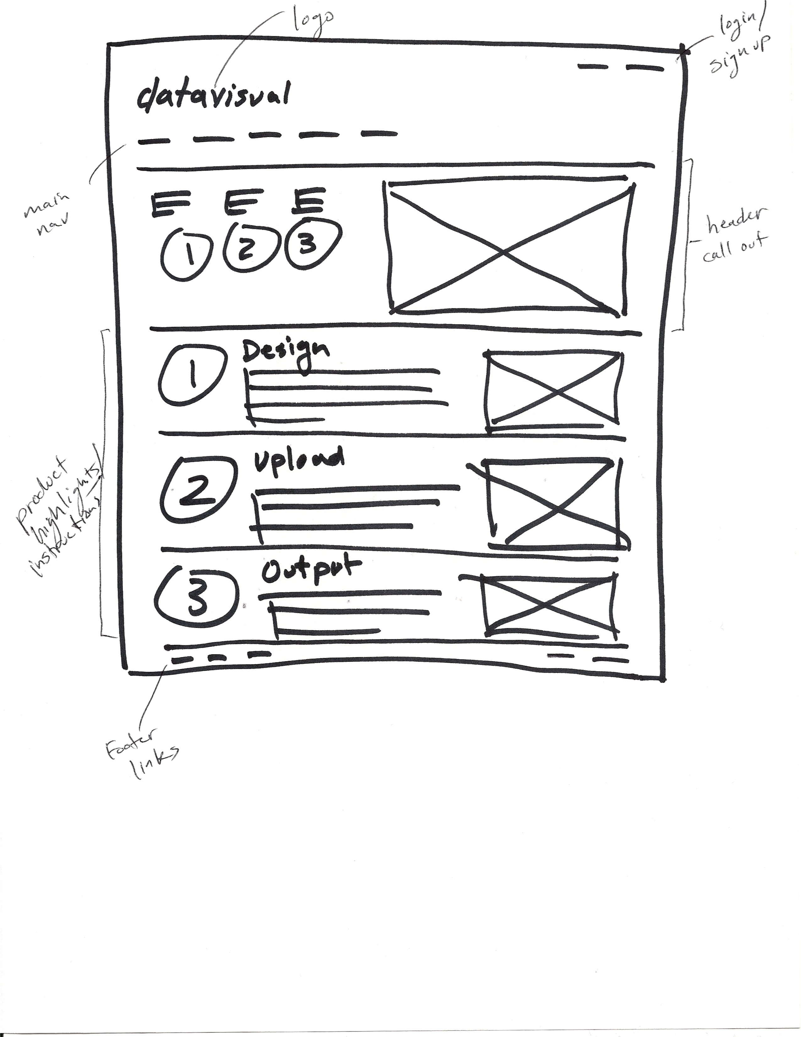
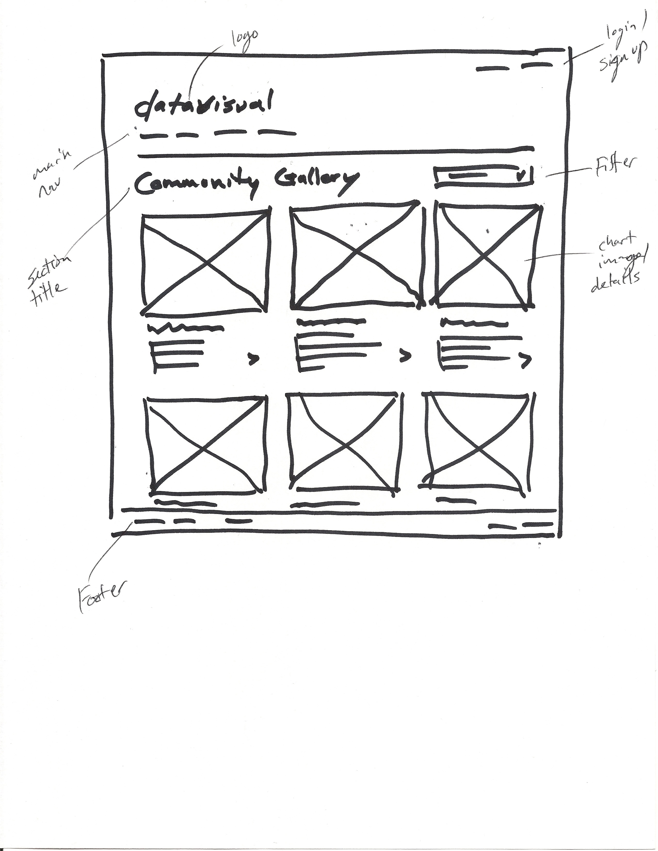
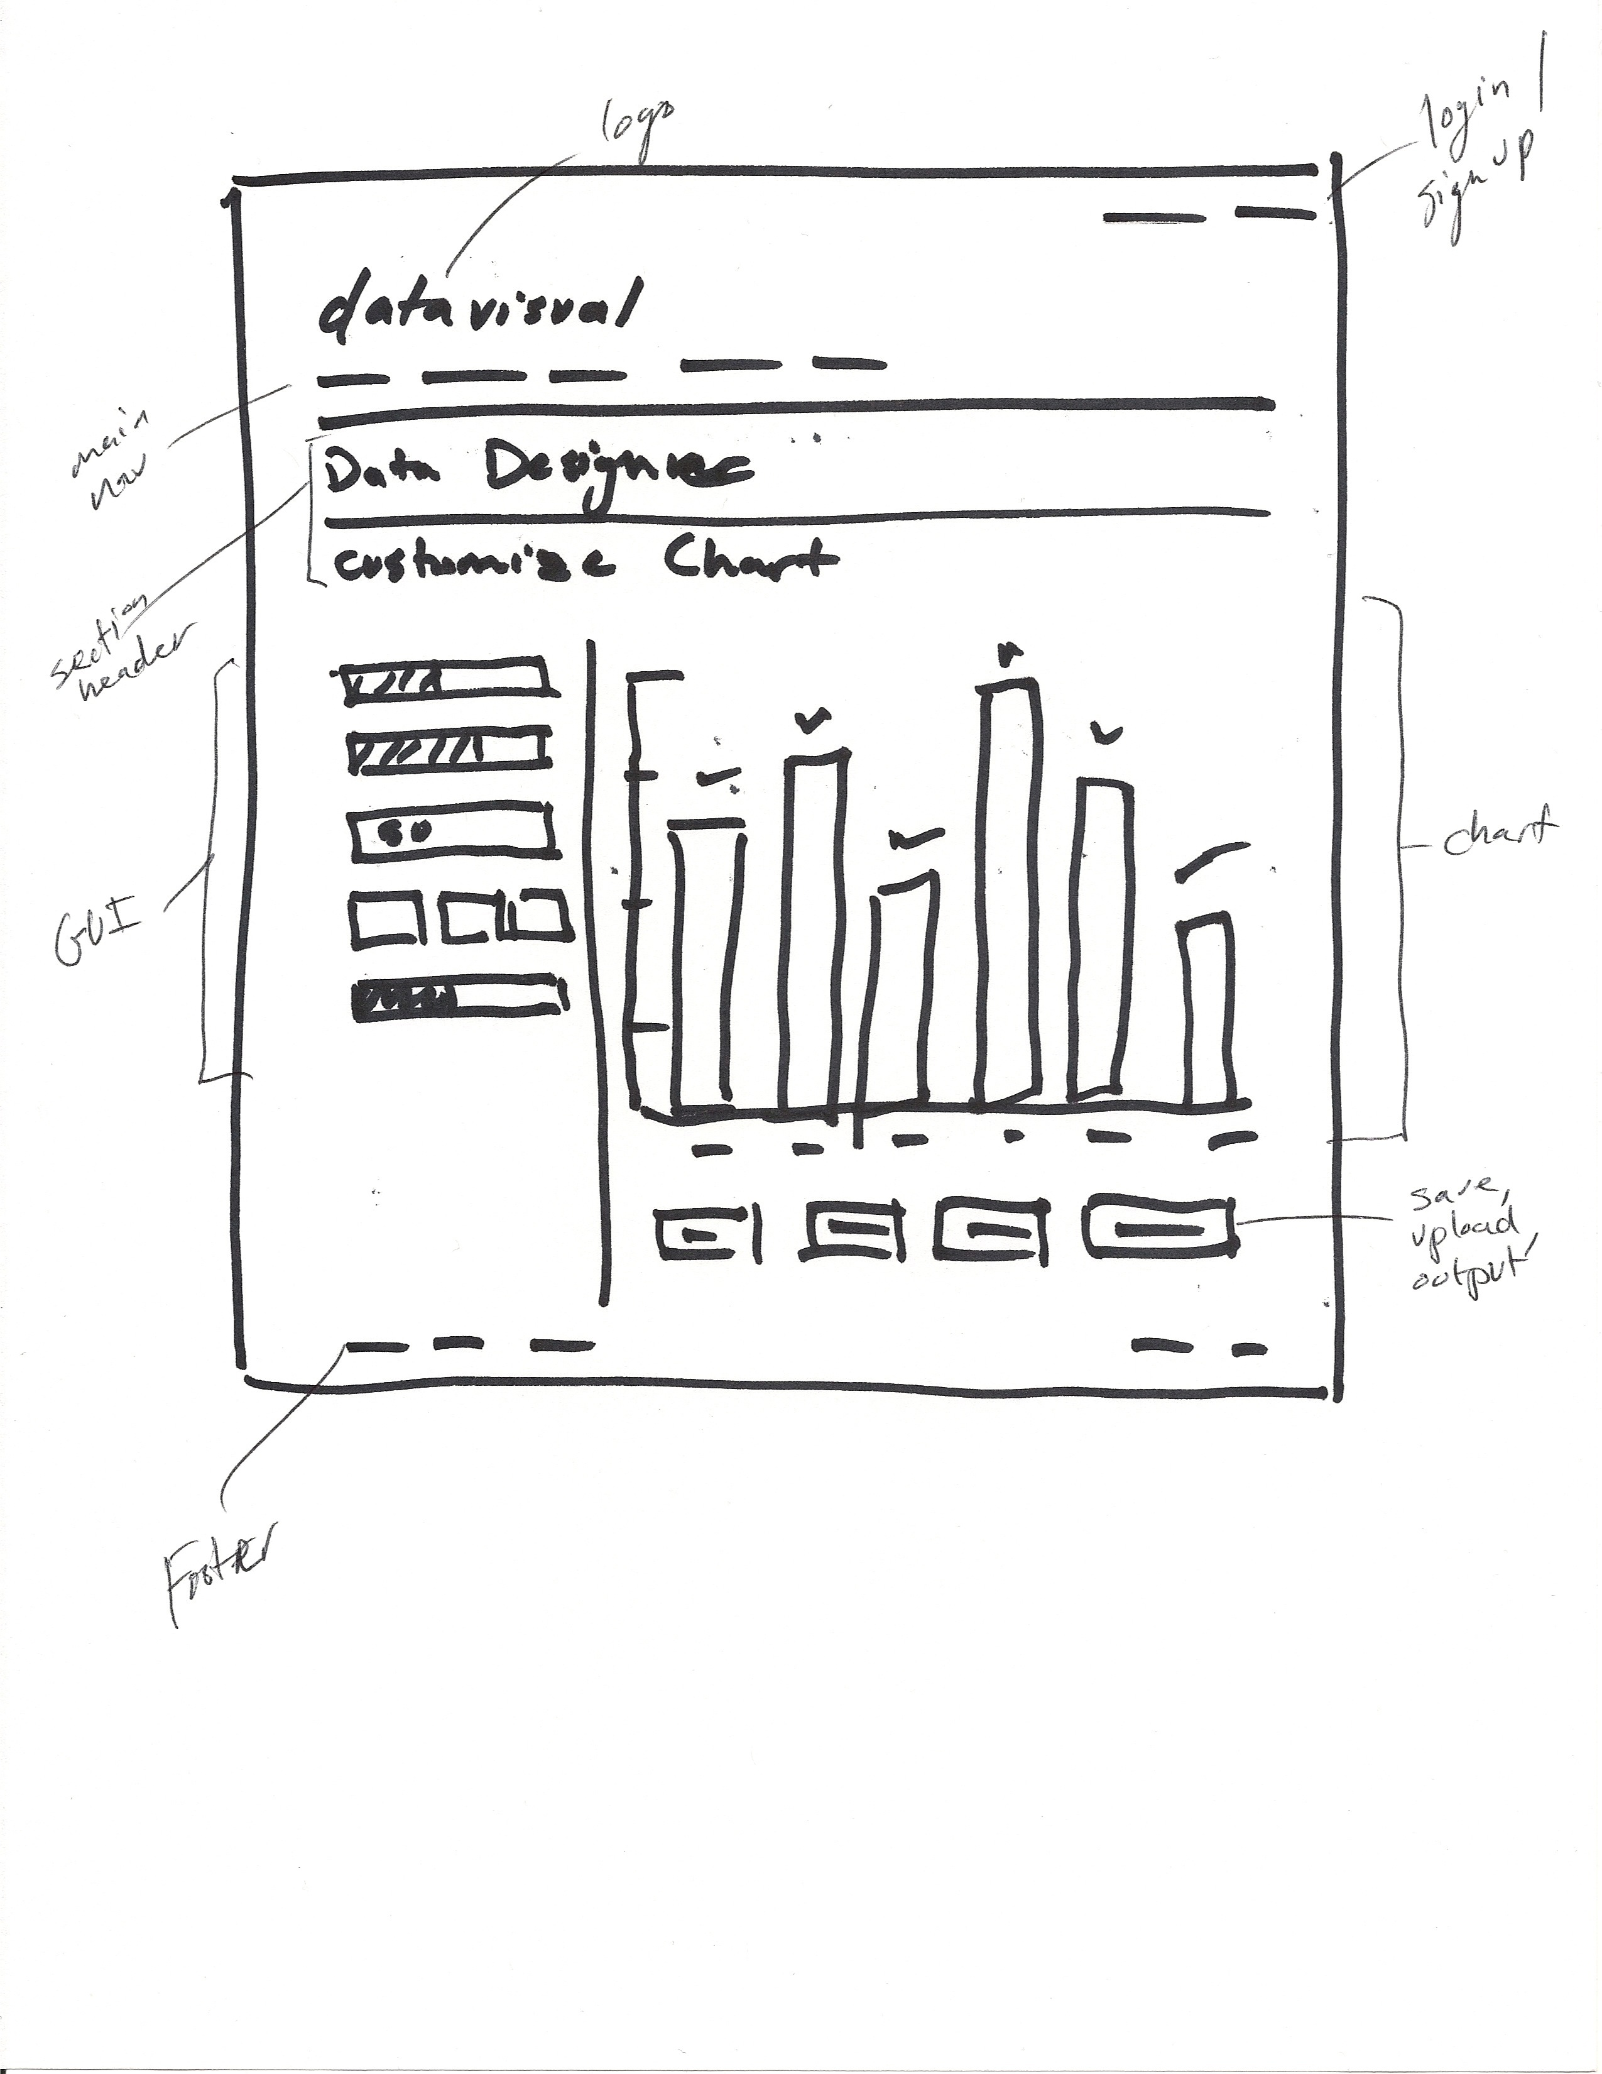
Define

Slide 11
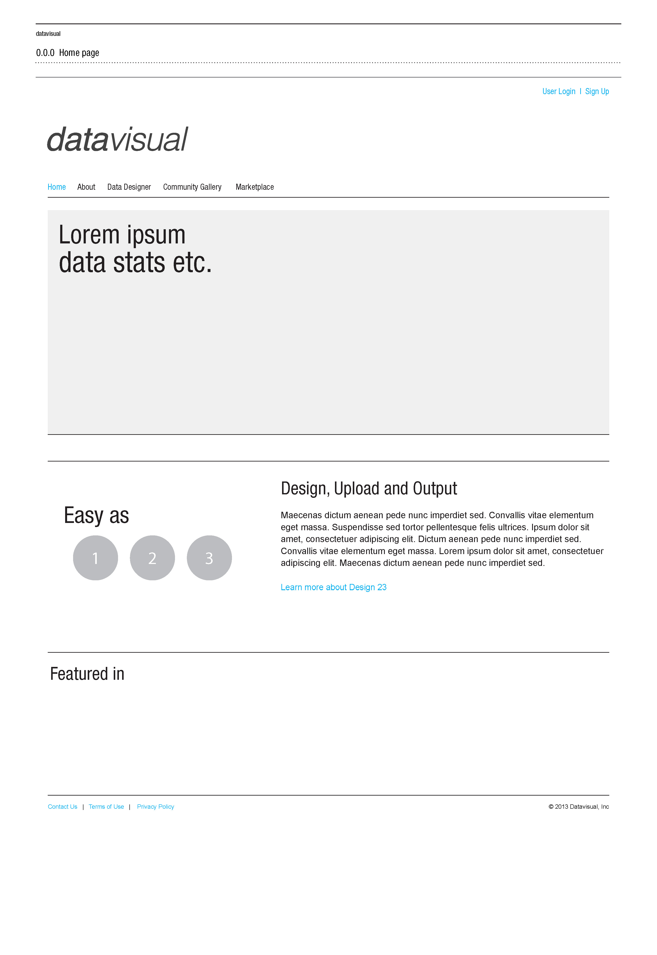
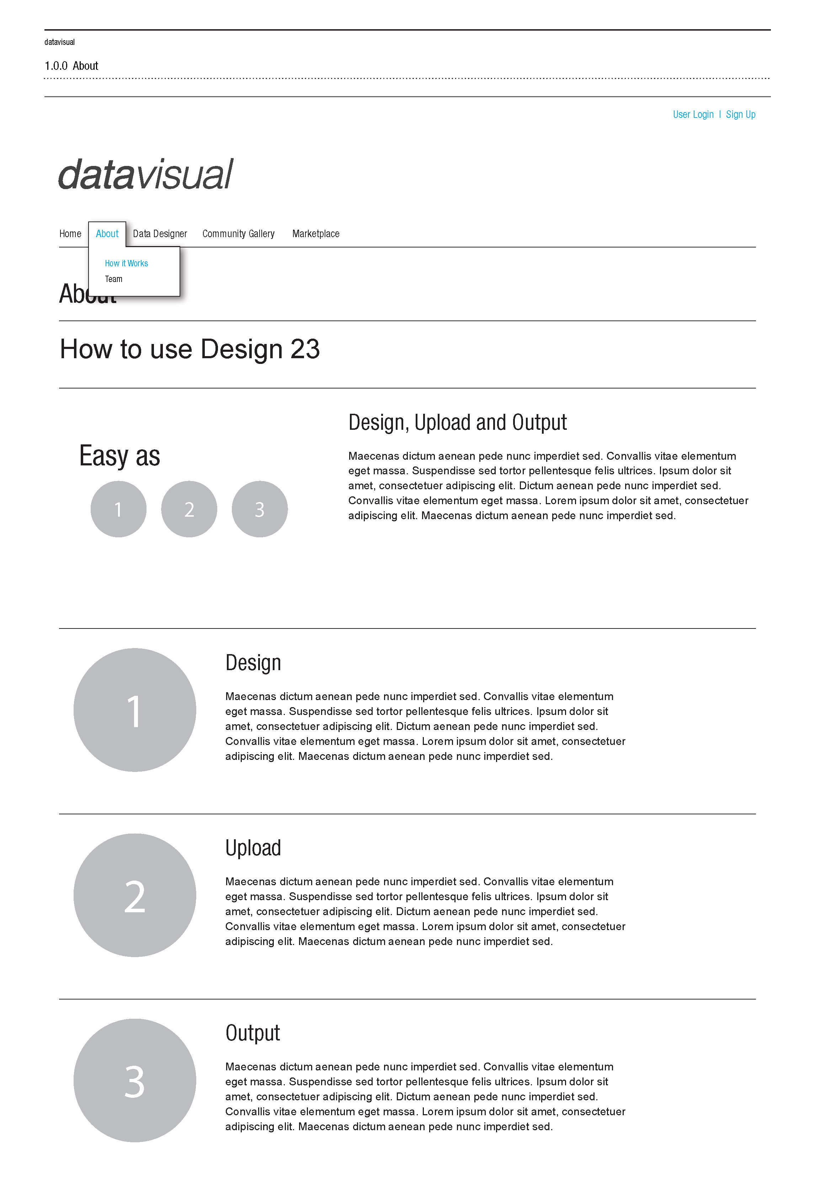
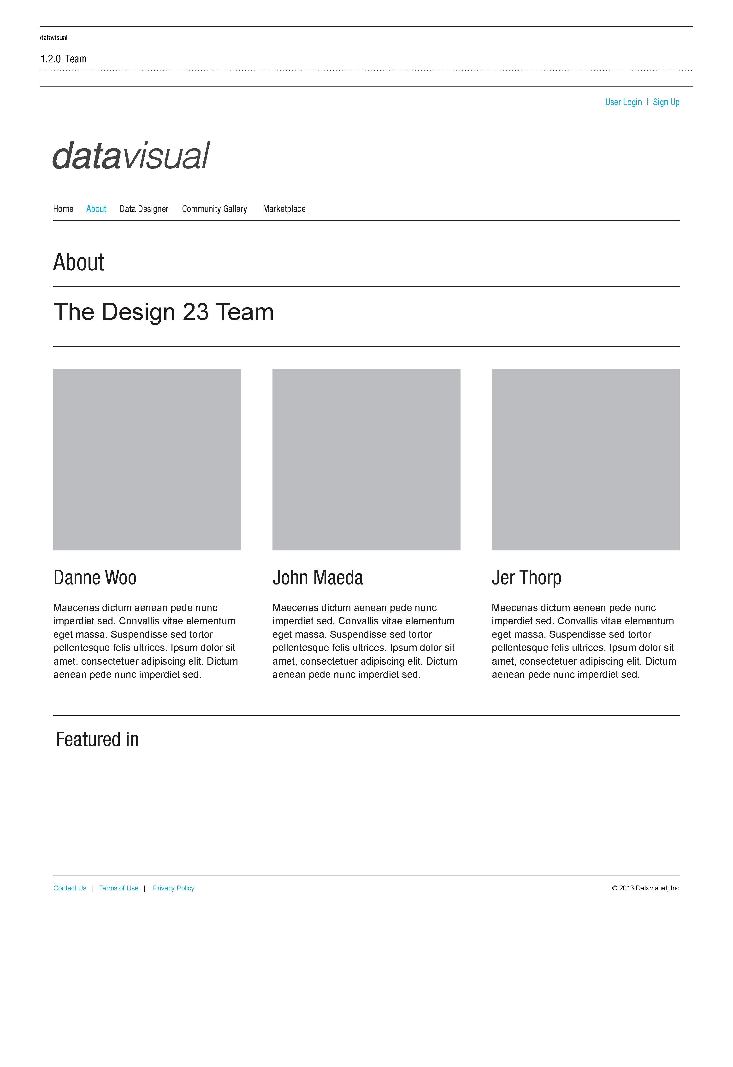
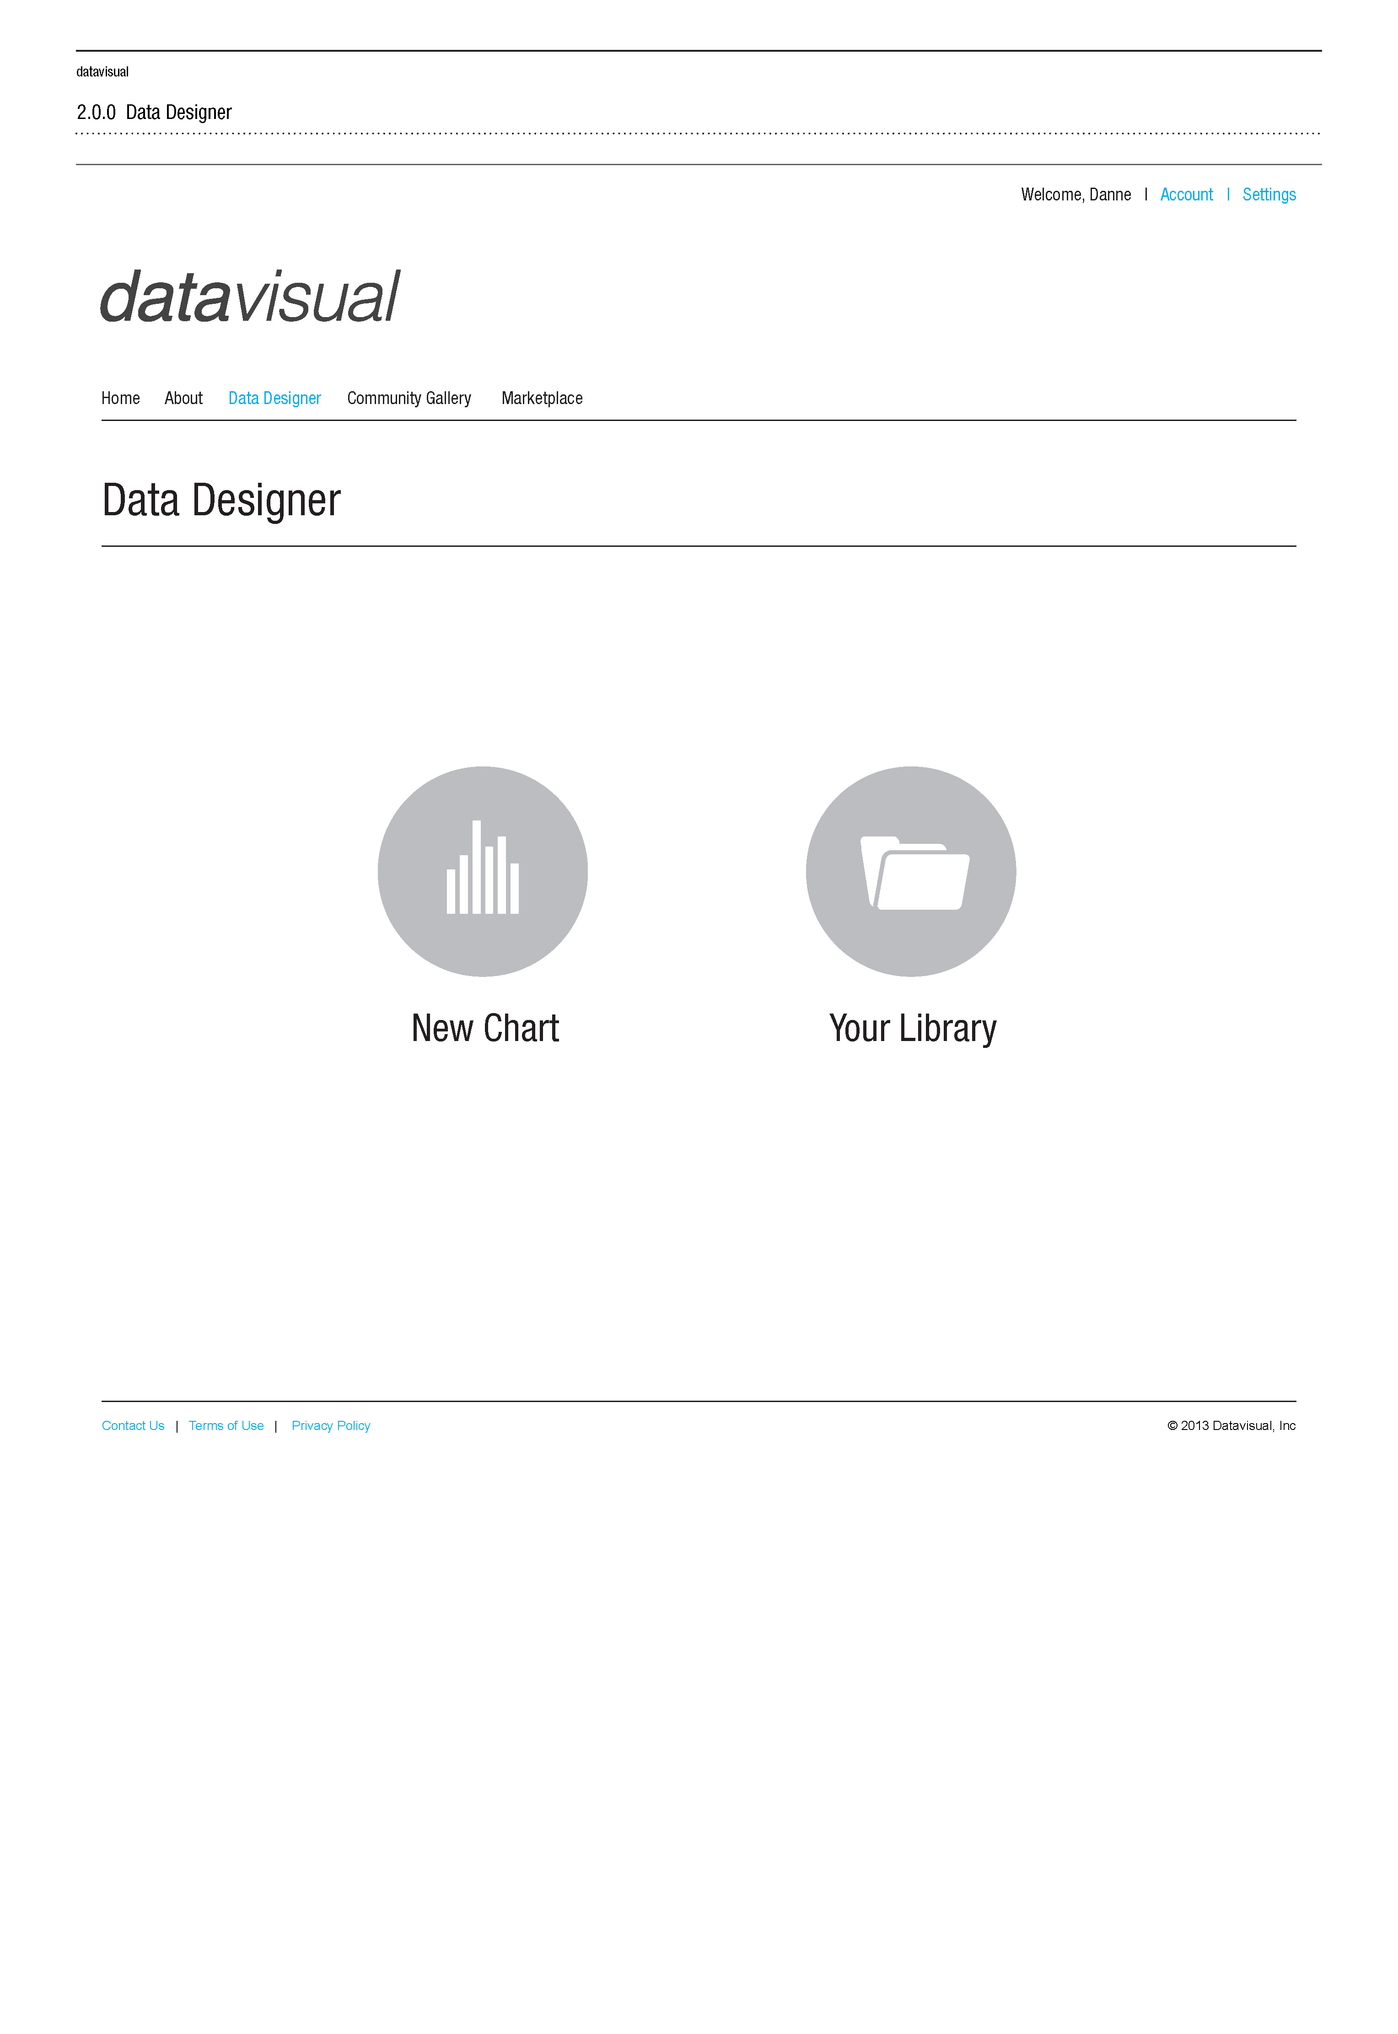
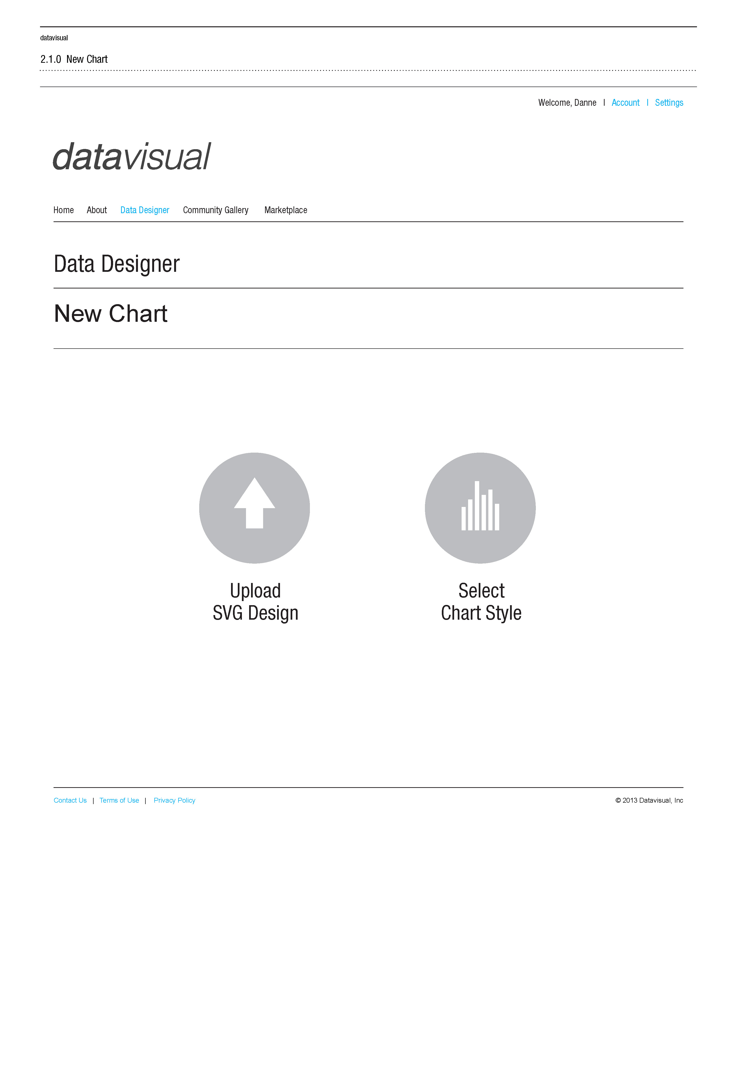
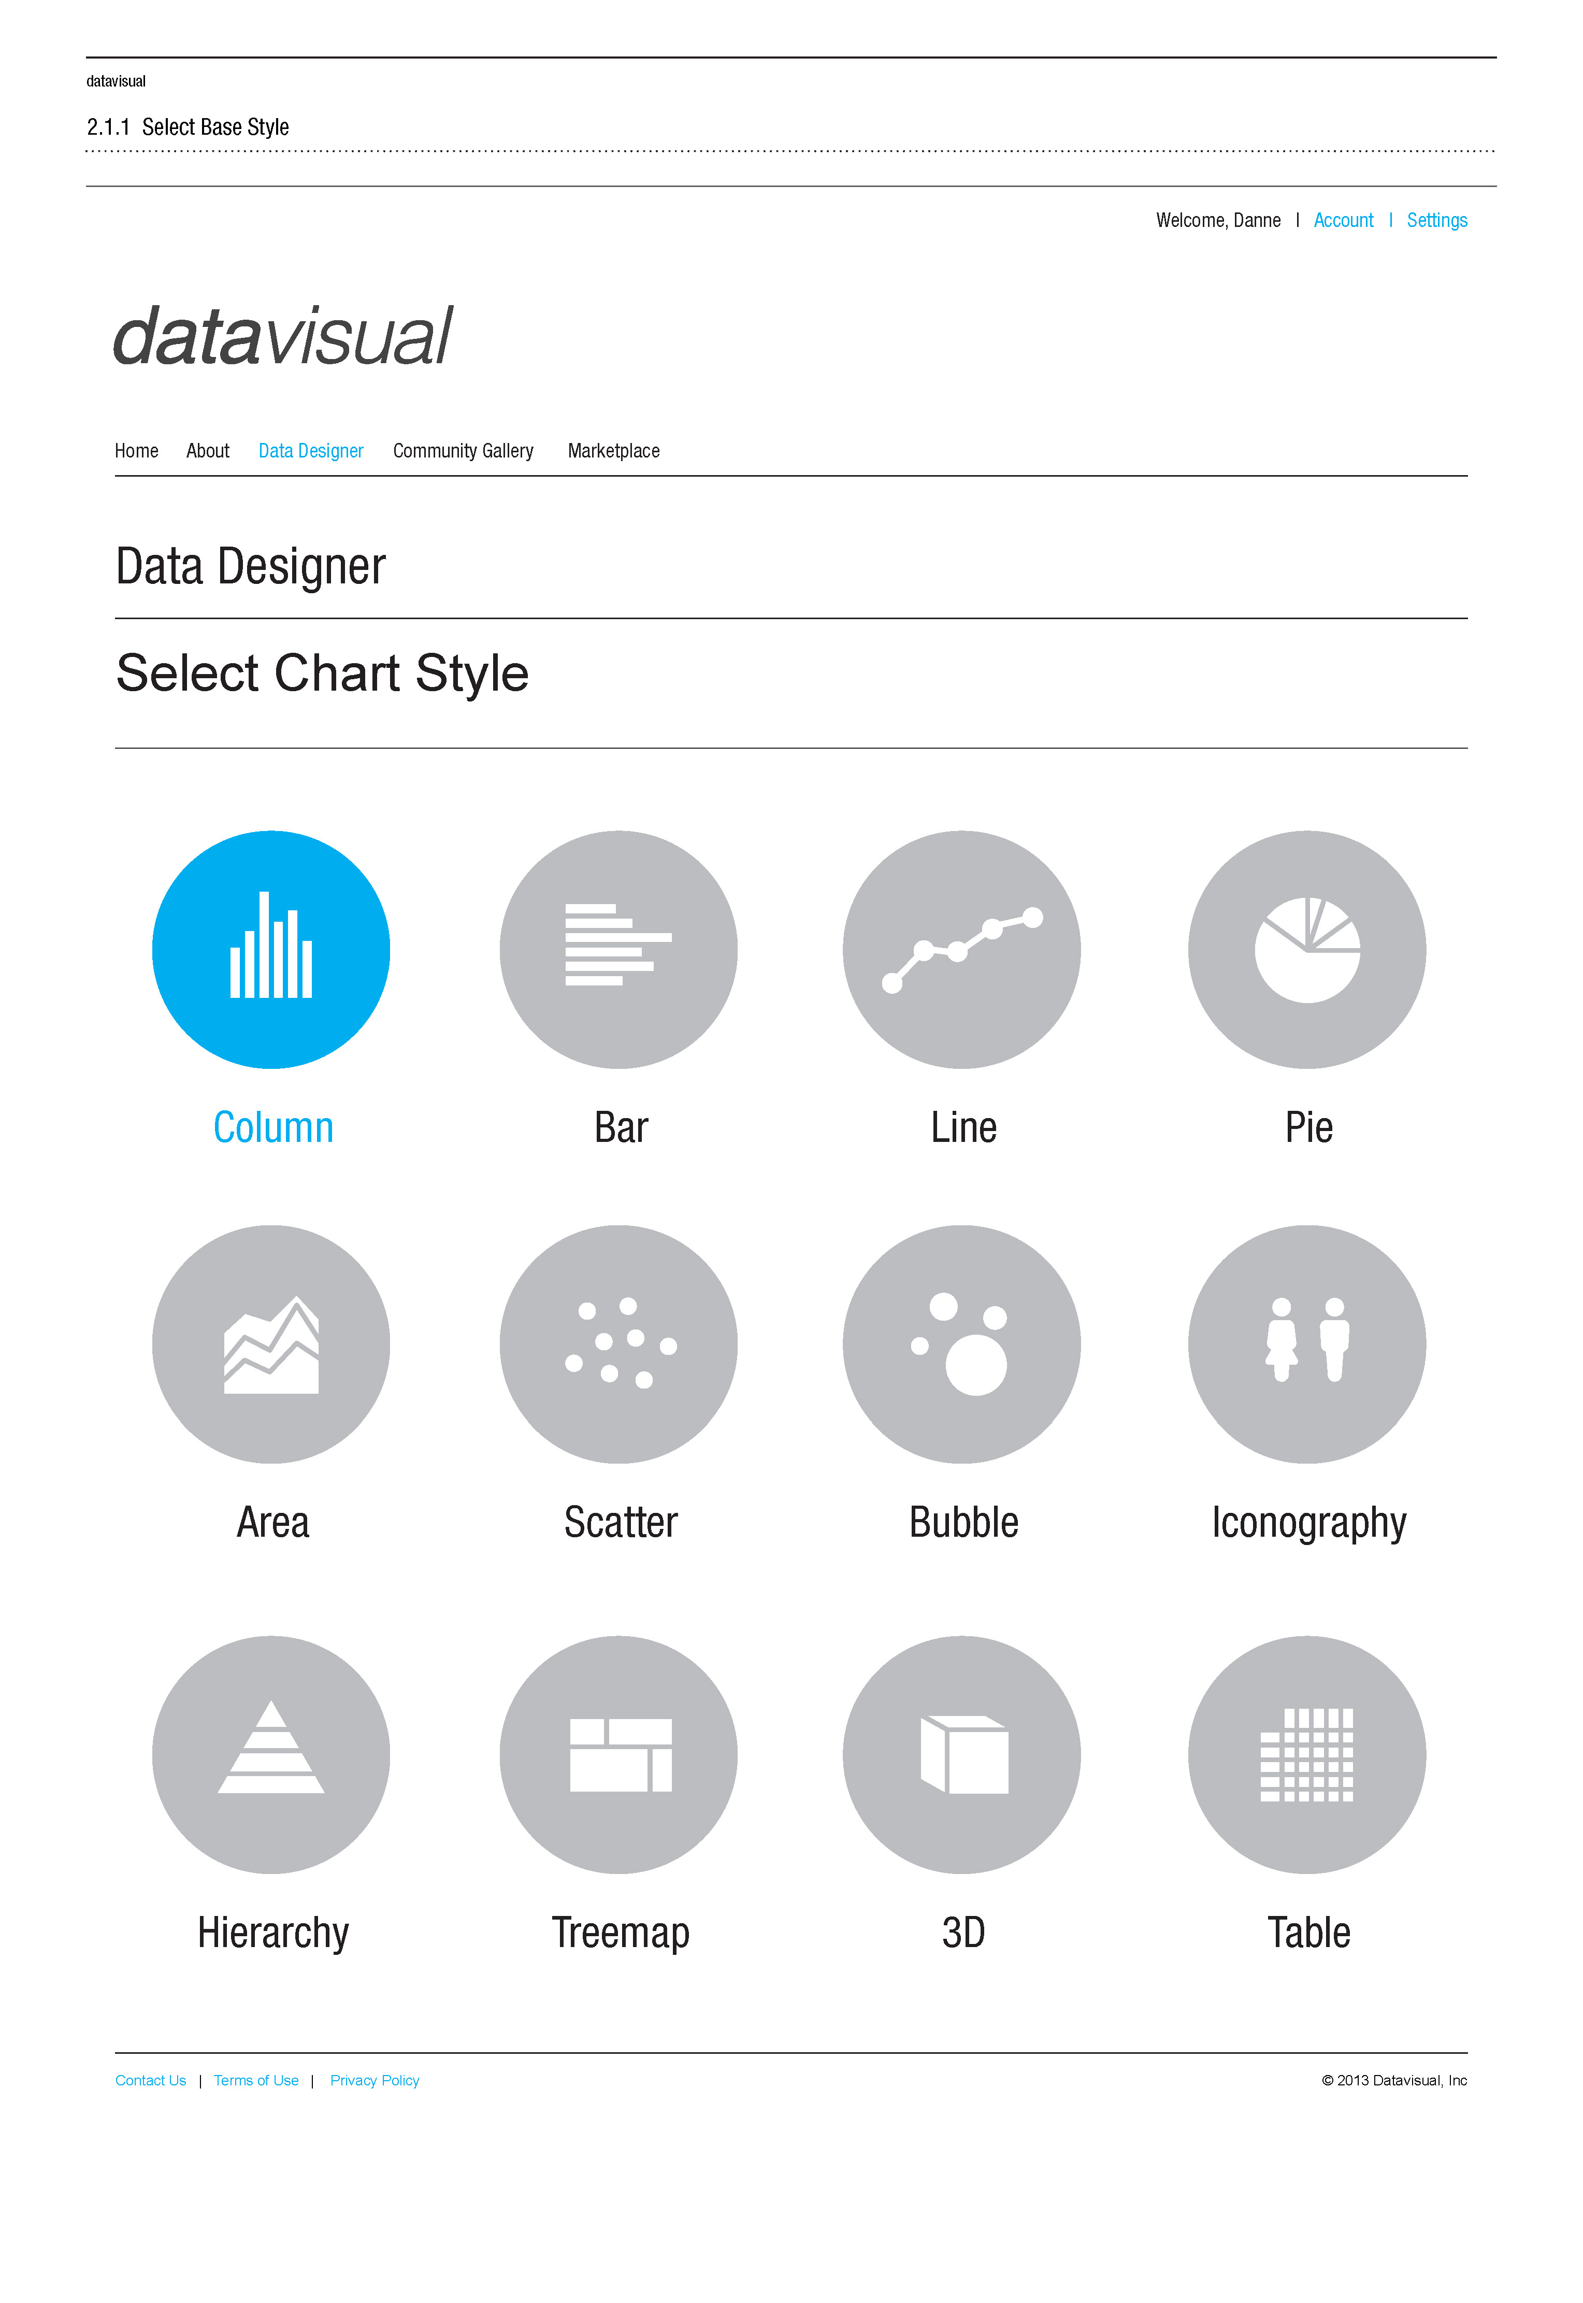
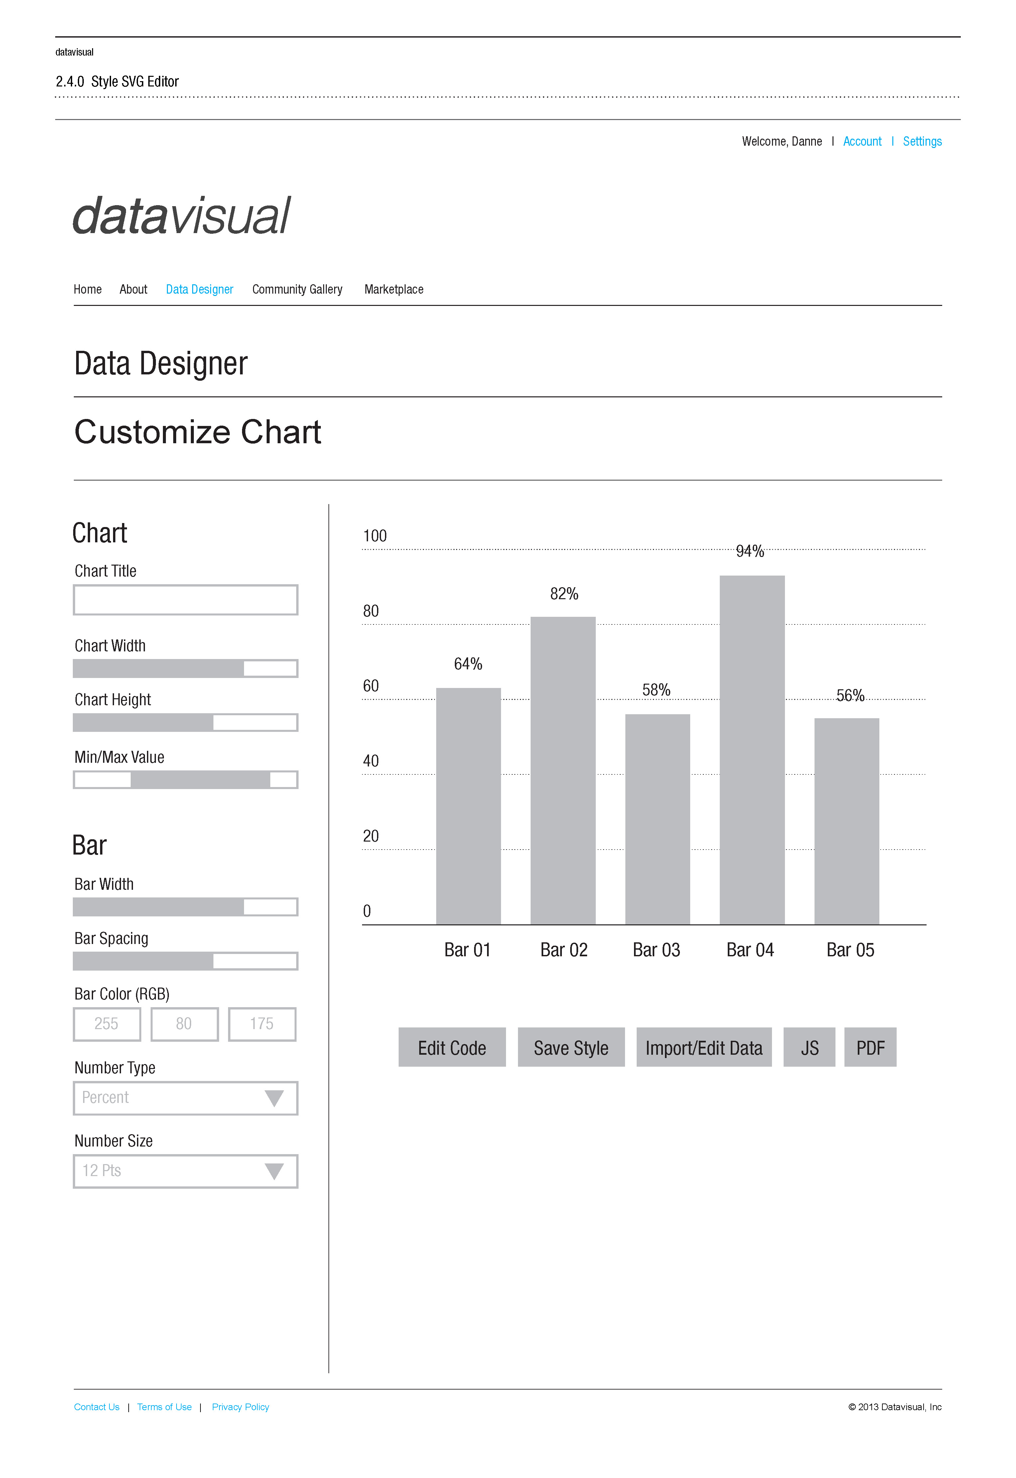
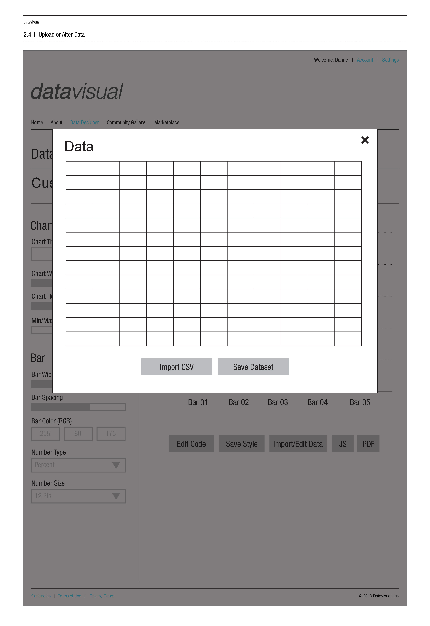
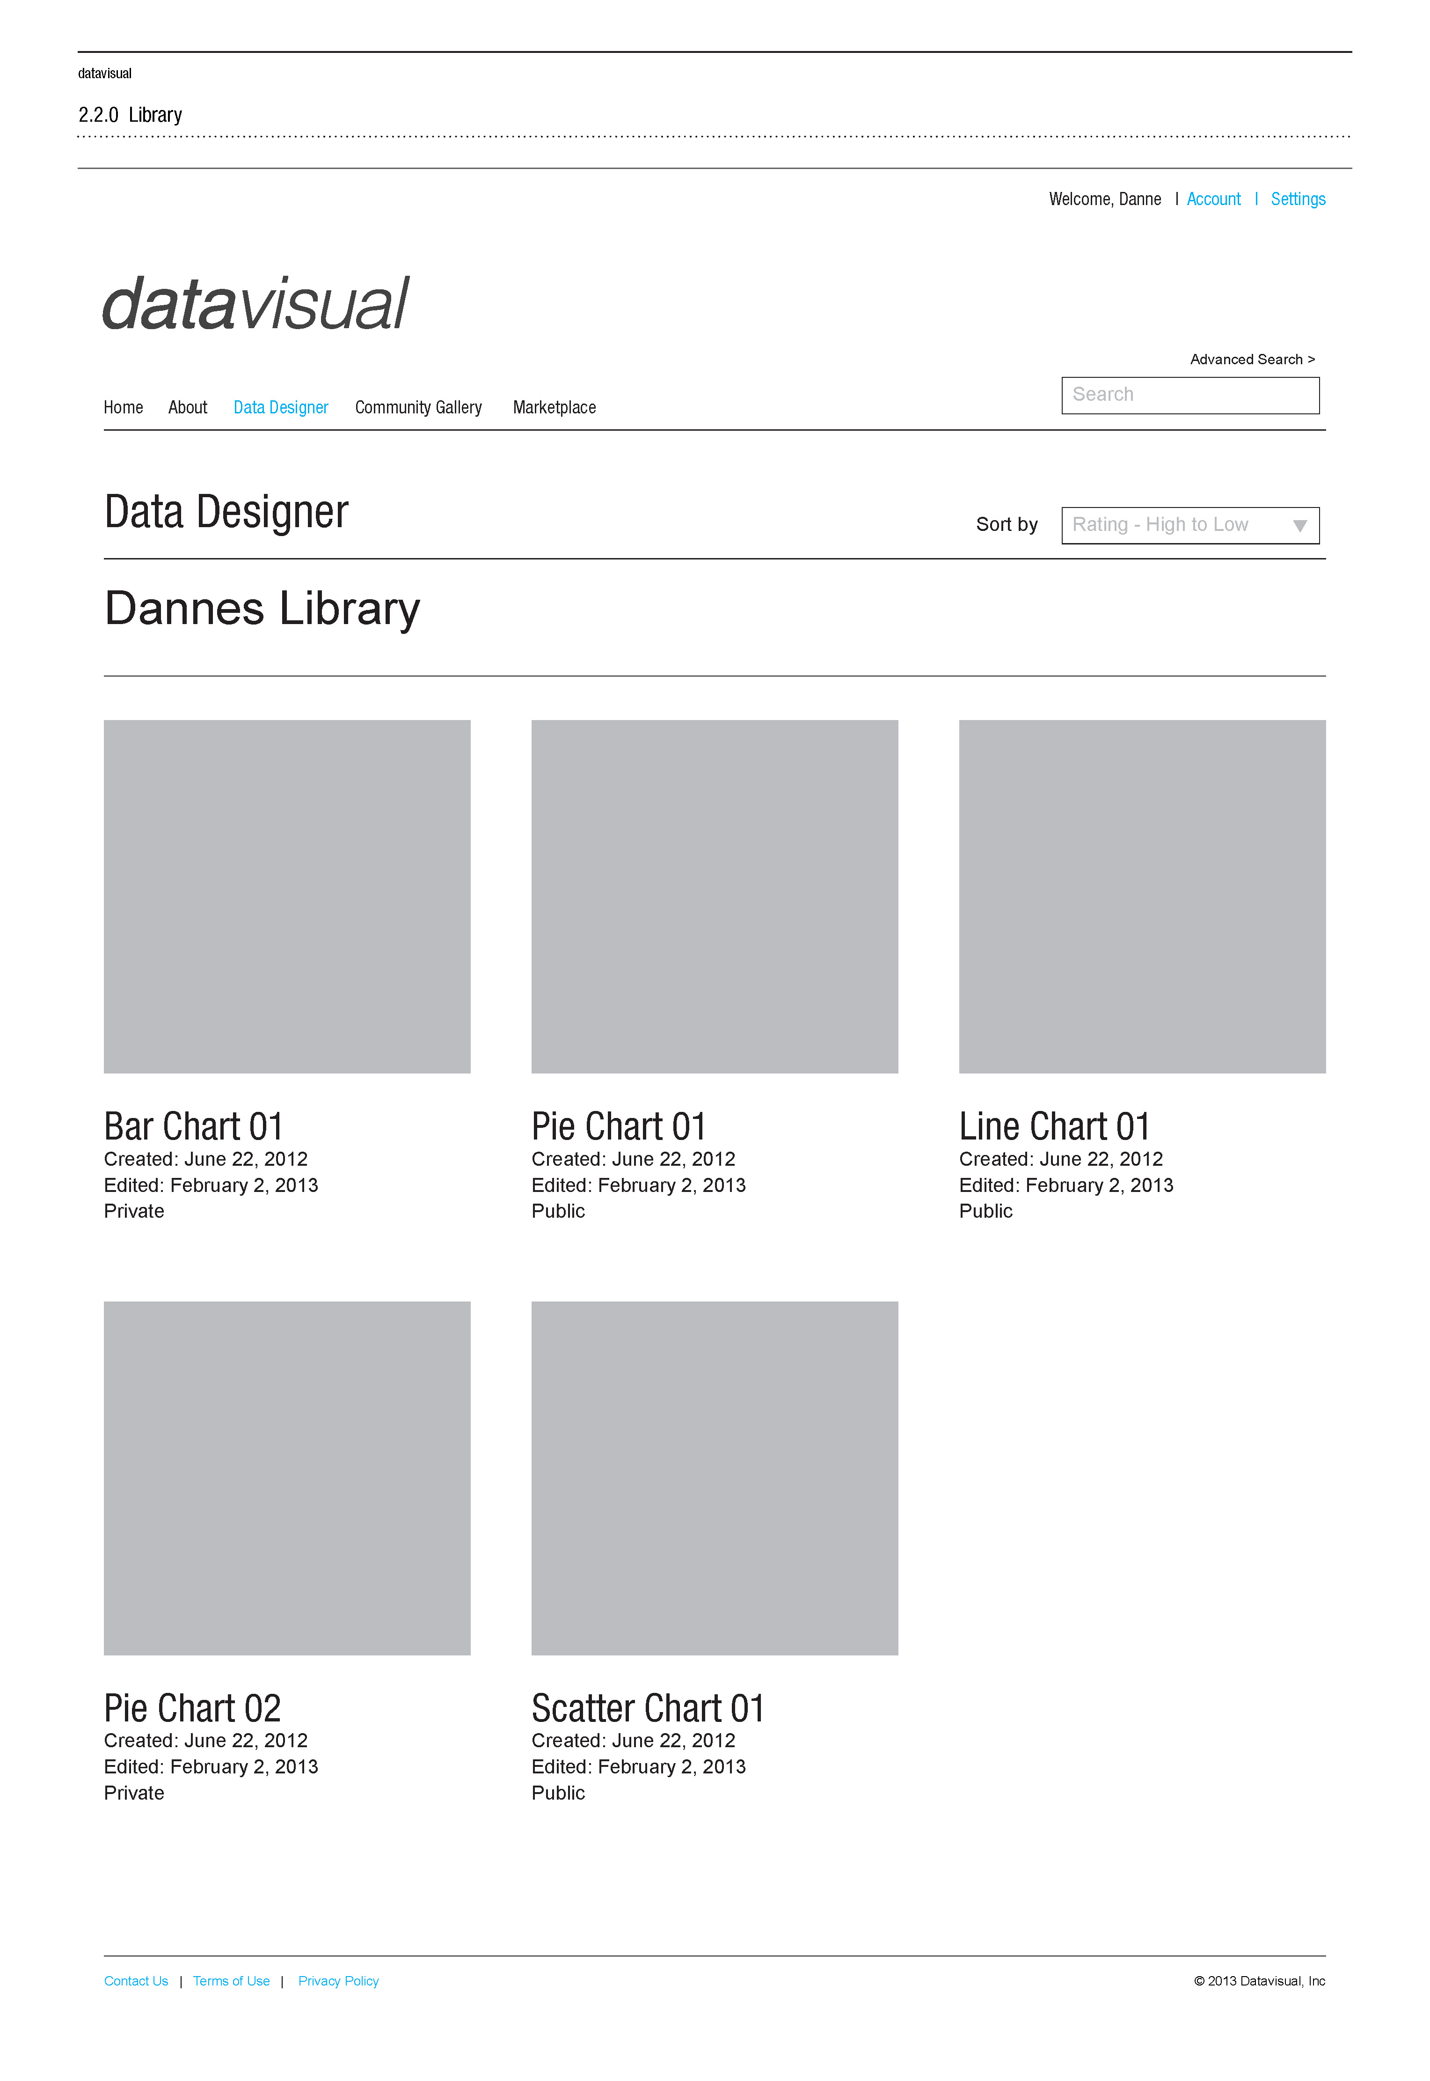
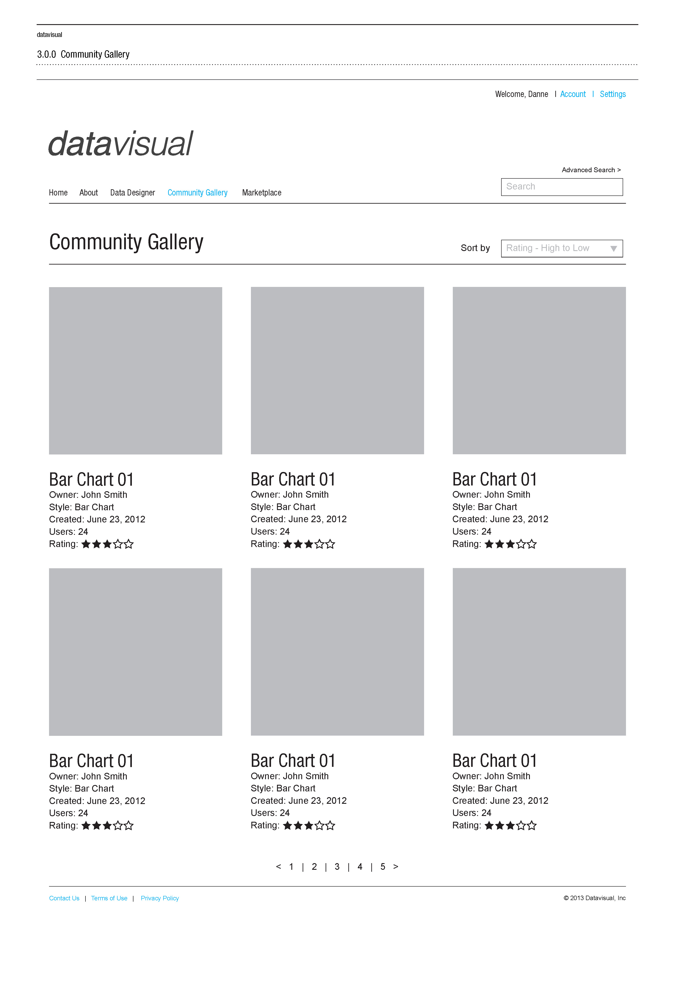
Define

Slide 12
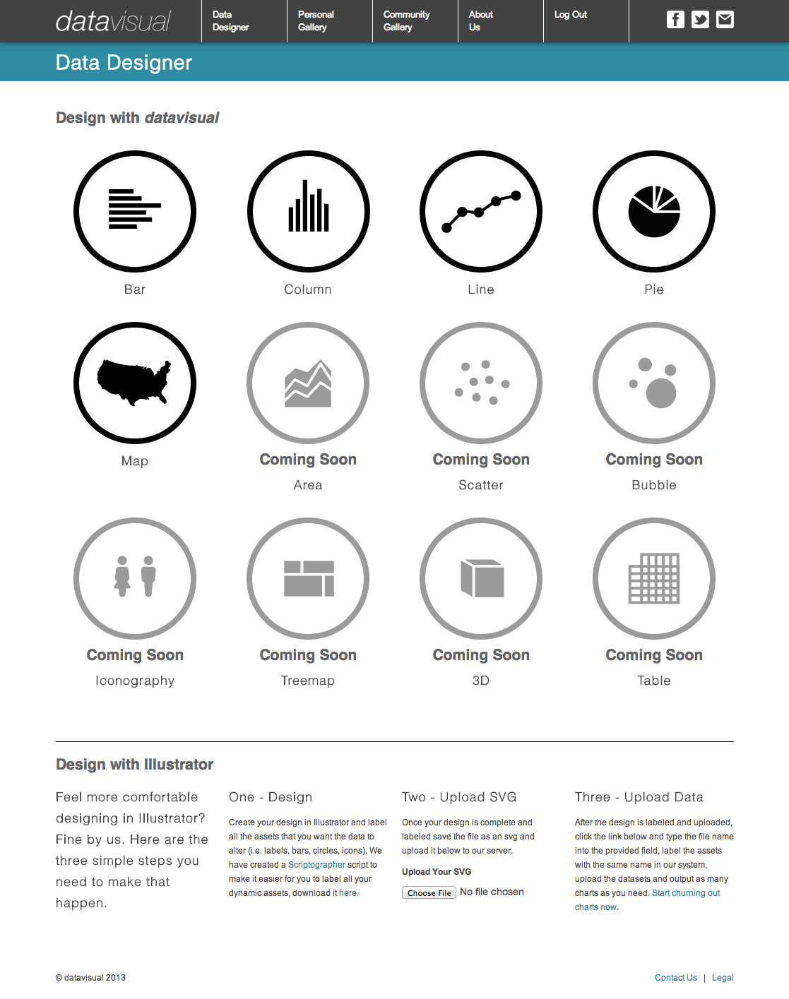
Define

Slide 13
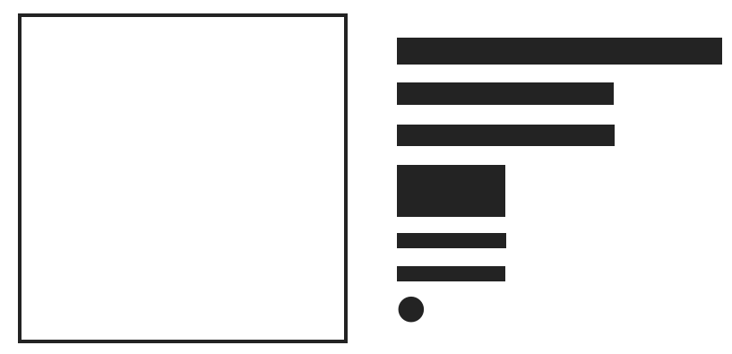
Design

Slide 14
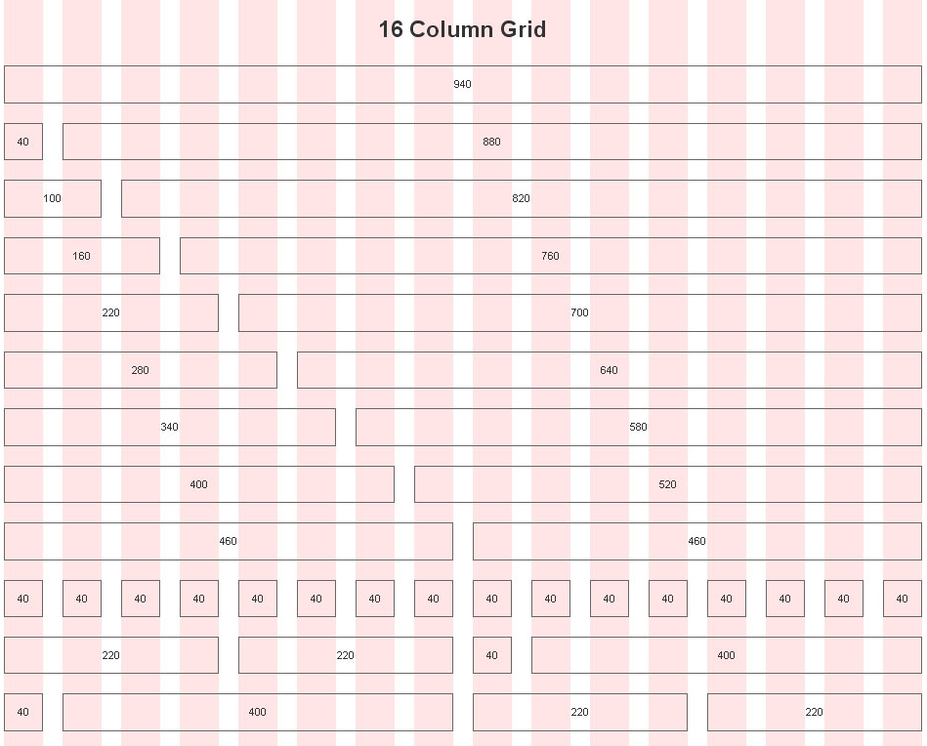
Design

Slide 15
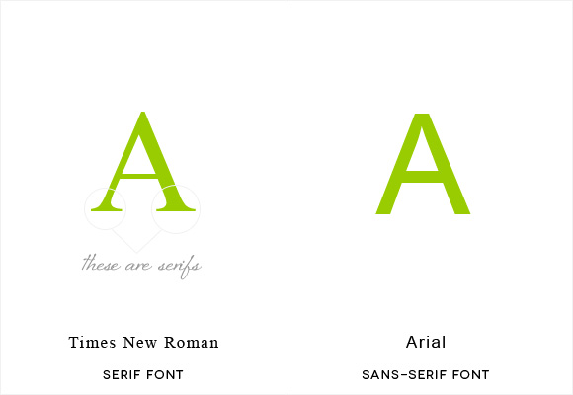
Design

Slide 16
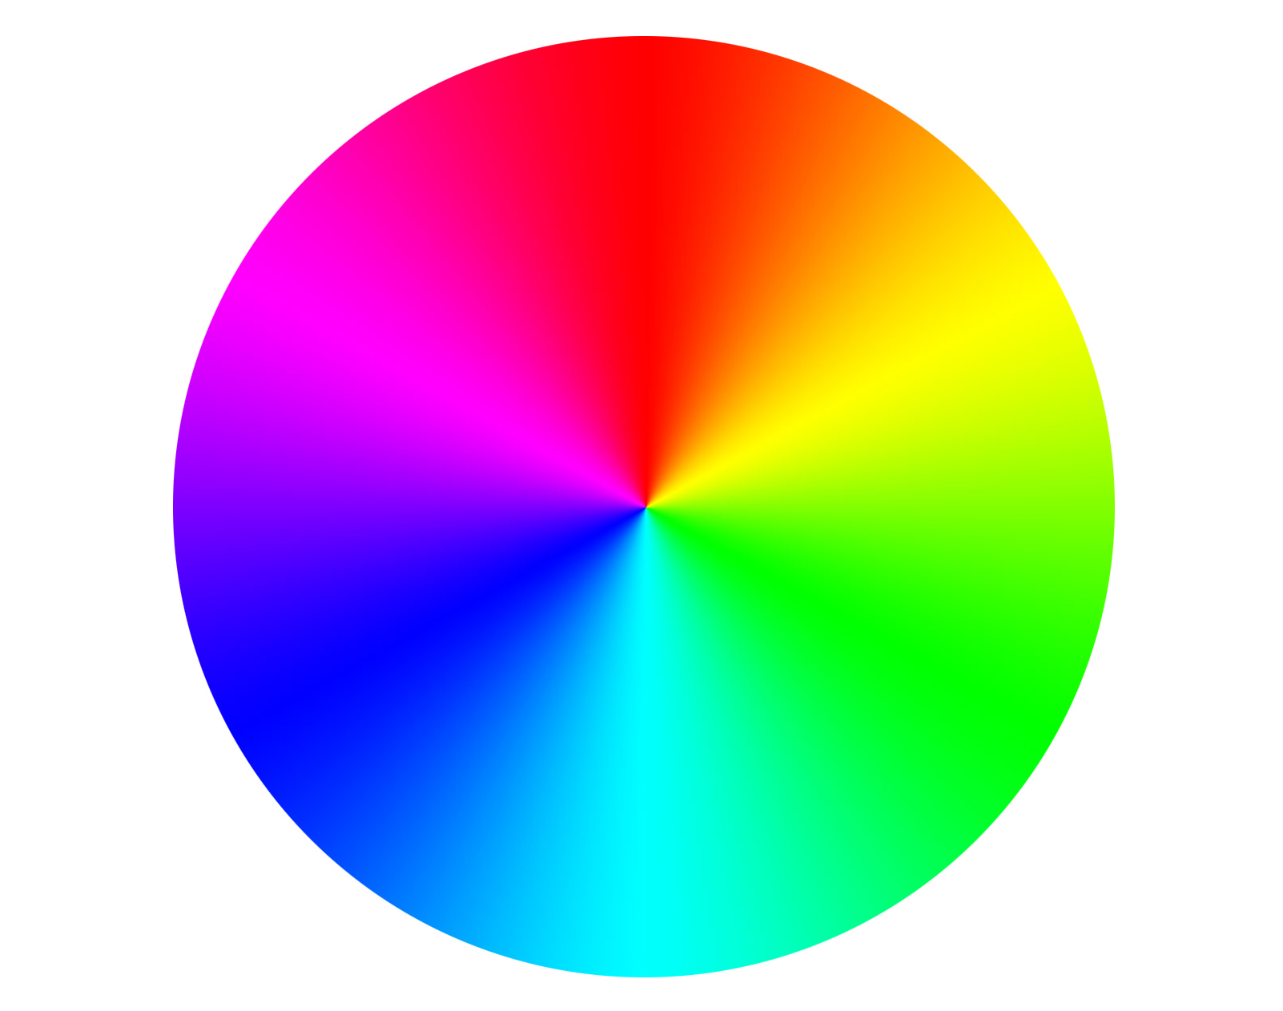
Design

Slide 17
Design
RGB
Hexadecimal (Hex)
CMYK
255, 255, 255
#FFFFFF
0, 0, 0, 0
0, 0, 0
#000000
100, 100, 100, 100
255, 0, 0
#FF0000
0, 80, 95, 0
0, 255, 0
#00FF00
44, 0, 63, 0
0, 0, 255
#0000FF
87, 61, 0, 0
255, 255, 0
#FFFF00
5, 0, 72, 0
120, 0, 120
#800080
50, 95, 0, 0

Slide 18
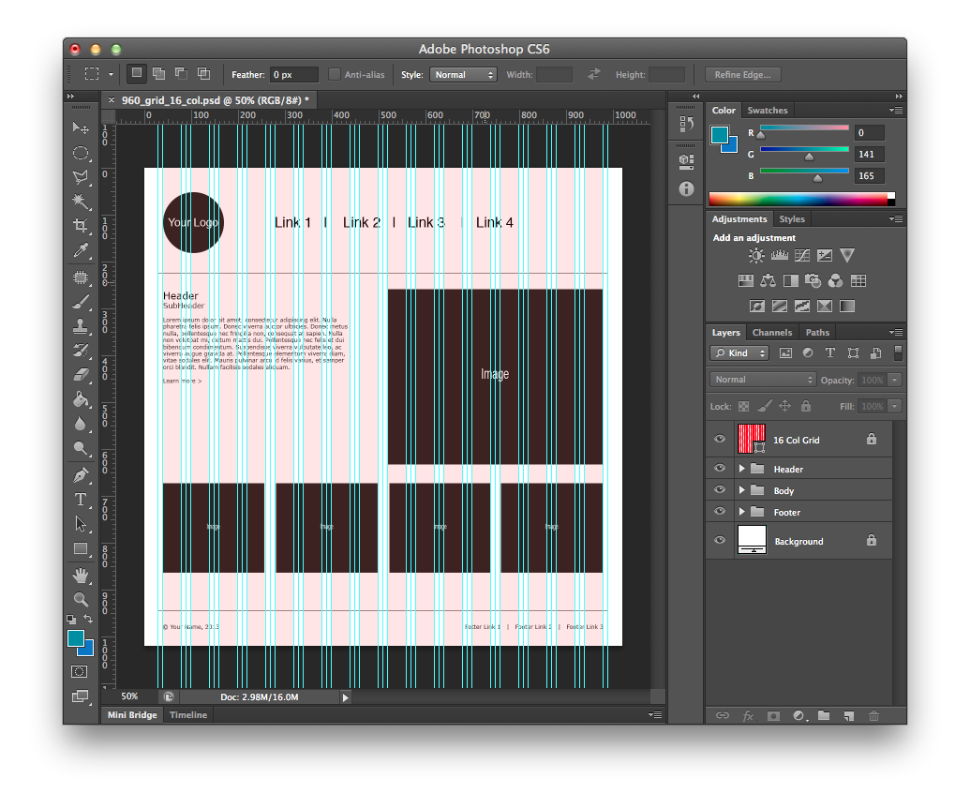
Design

Slide 19
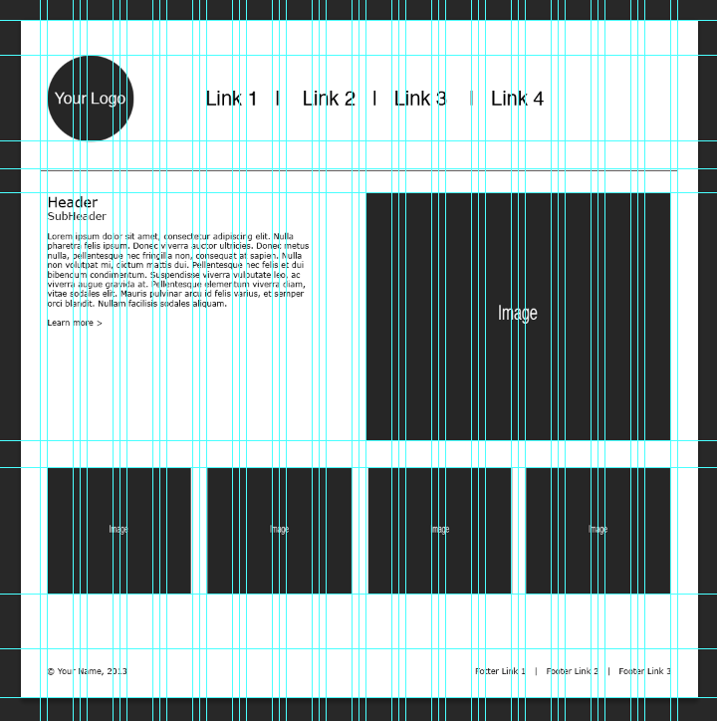
Development
460px
460px
52px
130px
42px
35px
374px
40px
191px
82px
74px
220px
220px
220px
220px

Slide 20
Development
Type
Header
Subhead
Body
Rollover
Rollover: Hover
Color
Background
Header
Body
Footer
Arial Bold, 24px, #000000
Arial, 18px, #000000
Arial, 10px, #000000
Arial, 10px, #000000, No Underline
Arial, 10px, #000000, Underline
#FFFFFF
#FFFFFF
#FFFFFF
#FFFFFF

Slide 21
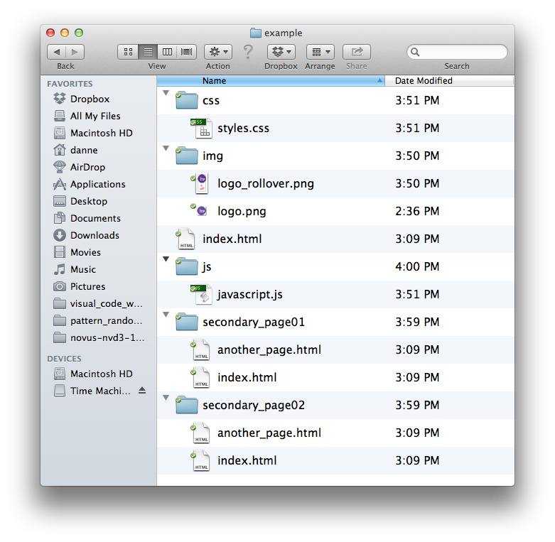
Development

Slide 22
Development
HTML
CSS
JavaScript
Basic Content
Layout and Design
Advanced Interactions and Animation

Slide 23
Development
<html>
<head></head>
<body style="background-color: #d0e4fe;">
<h1 style="font-family: Arial; font-size: 16px;">
Content goes here.
</h1>
</body>
</html>

Slide 24
Development
<html>
<head>
<style>
#divID { width: 100px; }
.divC { color: #FFFFFF; }
</style>
</head>
<body>
<div id=“divID” class=“divC”></div>
</body>
</html>

Slide 25
Development
<html>
<head>
<link href="css/layout.css" rel="stylesheet" type="text/css">
</head>
<body>
<div id=“divID” class=“divC”>
<h1>Content goes here.</h1>
</div>
</body>
</html>

Slide 26
Development
HTML
Attach Styles to HTML Tags
(i.e. body, h1, p, li, ul, a, tr, td)
#ID
Unique Object / div
(i.e. layout, width, height, position, etc.)
.class
Reusable Styles / div, span, HTML tags
(i.e. color, type-family, type-size, etc.)

Slide 27
Development
Helpful Libraries
CSS
Twitter Bootstrap (getbootstrap.com)
960 (960.gs)
Foundation (foundation.zurb.com)
JavaScript
Twitter Bootstrap (getbootstrap.com)
jQuery (jquery.com)
D3js (d3js.org)
ThreeJS (threejs.org)
And on and on and on…
Notes:
Twitter Bootstrap, general CSS and JavaScript framework.
960 is for grid systems.
Foundation is for responsive web development.

